Slide 1
Introduction to Python
Nate Mahalingam
Crosby MBA 2018

Slide 2
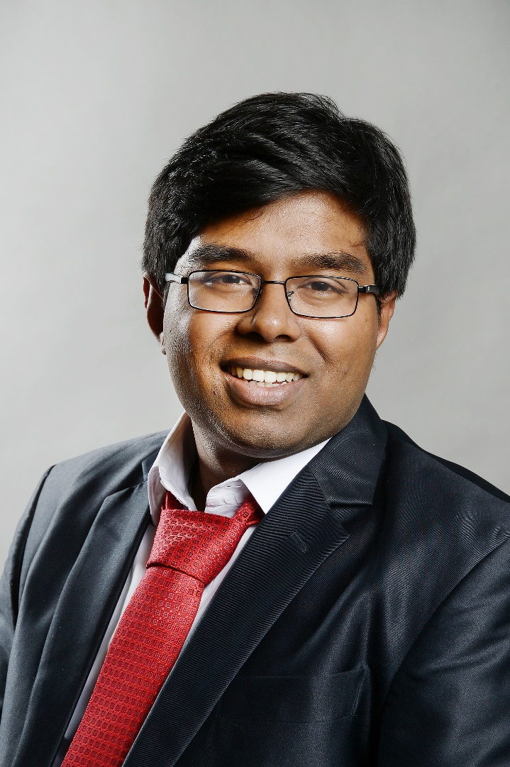
Who am I?
Second year Crosby MBA student focusing in Marketing Analytics
Born and raised in South India
Bachelor’s and Master’s in Chemical Engineering from the UK
Around 4 years of experience with Python
Major projects
Delivering the AP news on the Amazon Echo
Text classification for Sears
Notes:
Maybe add the video of the echo demonstration?

Slide 3
Who is this class for?
If you’re a complete beginner in programming

Slide 4
Who is this class NOT for?
If you are looking a cookbook of Python recipes
Hardcore programmers
If you’re looking for super advanced stuff

Slide 5
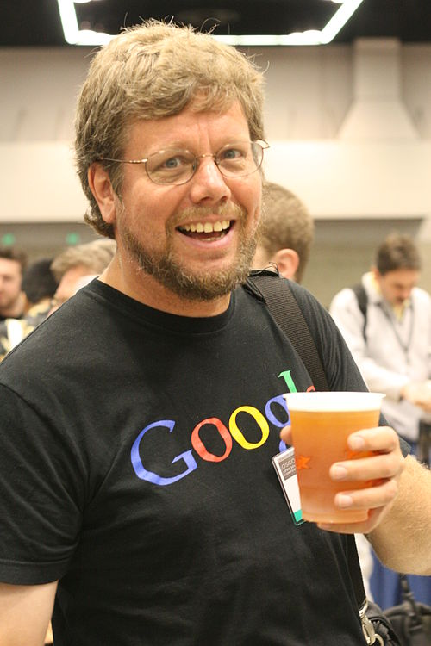
What is Python?
Invented by Guido van Rossum in 1991

Slide 6

Named after Monty Python’s Flying Circus

Slide 7
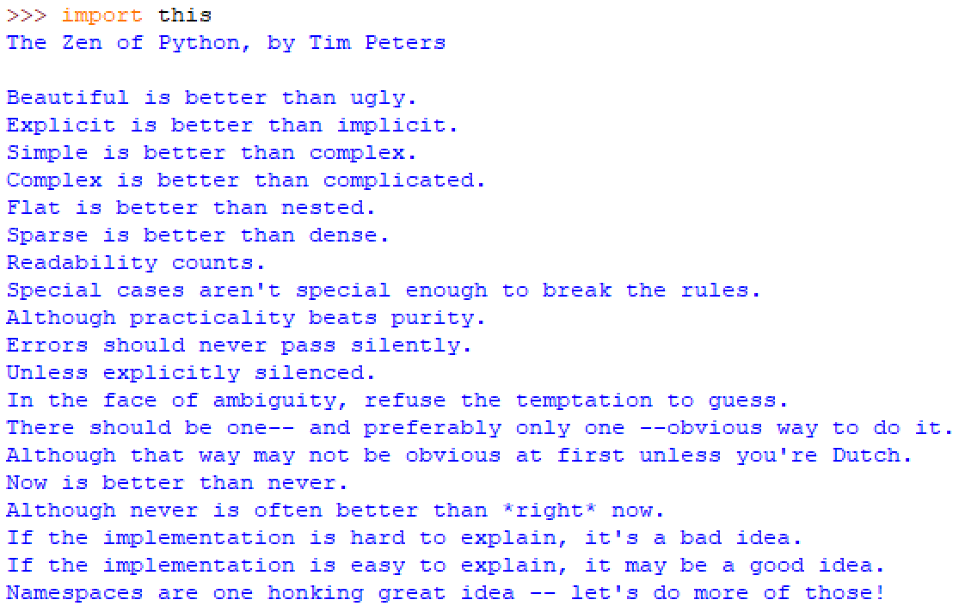
Philosophy of Python

Slide 8
Why Python?
Easy to learn!
Fast! – Almost as fast as C or C++
Extensive library
Quick and dirty development
Completely free

Slide 9





Famous software

Slide 10
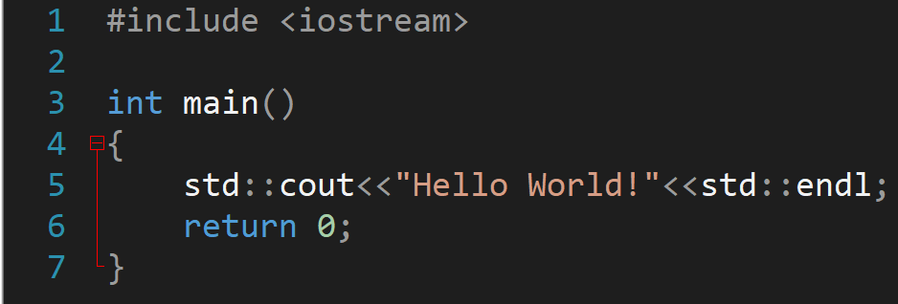
Syntactic Sugar
Header file
Preprocessor statement
Namespace std
Brackets
Function declaration
Overloaded bitwise shift operator
Normal exit status
Semicolons

Slide 11
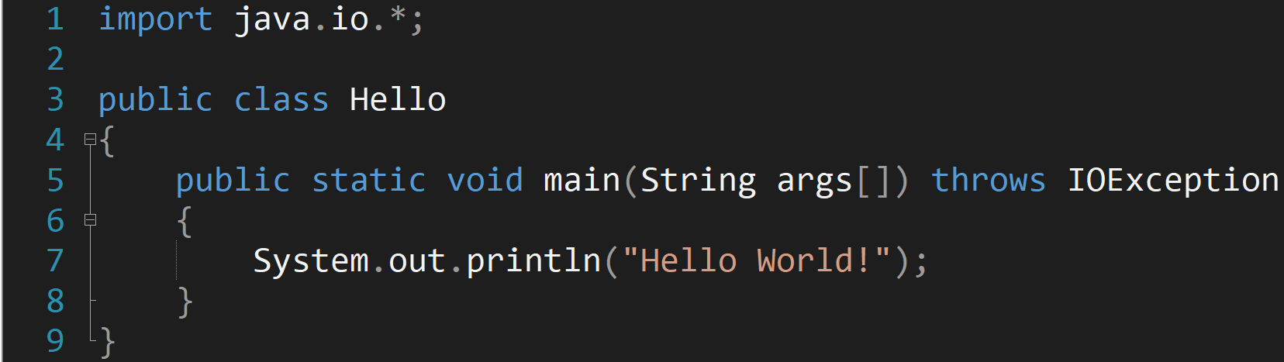
Import everything from java.io package
Class declaration
Main function declaration
Print function
Semicolons
Even more brackets

Slide 13
